Slide 1
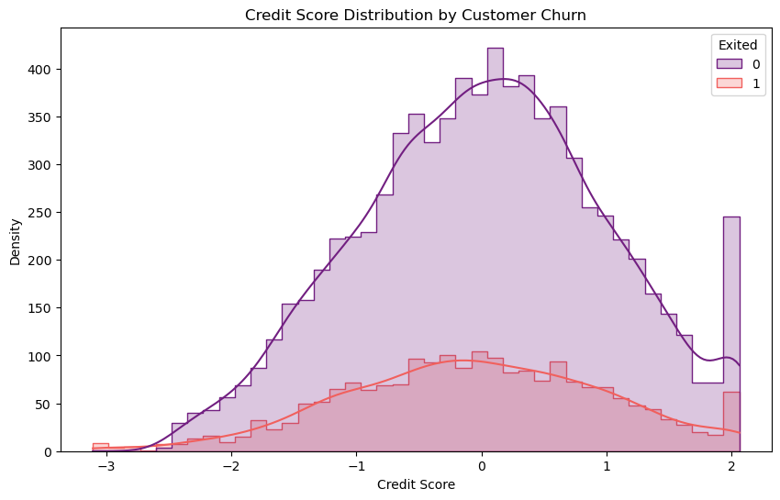
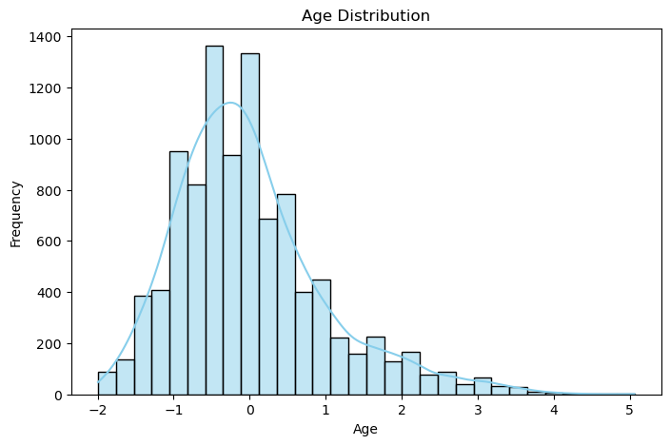
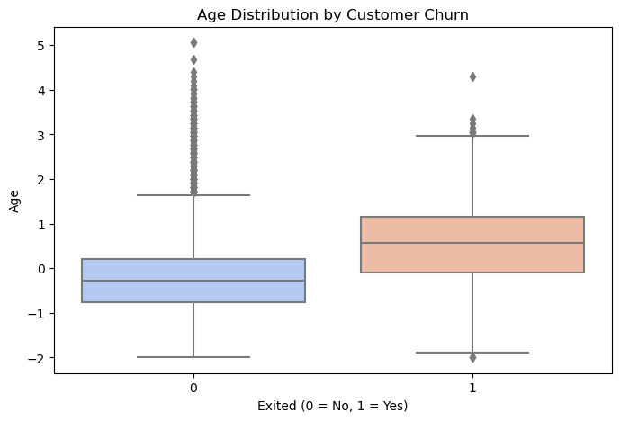
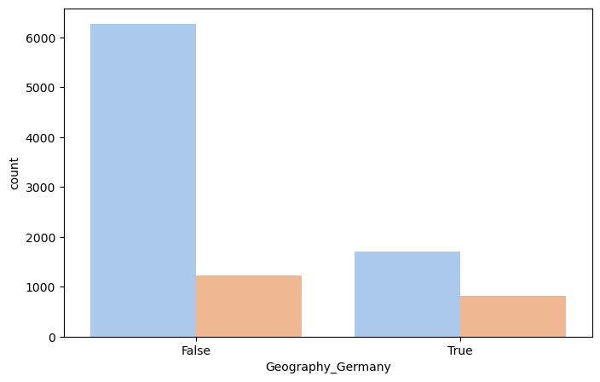
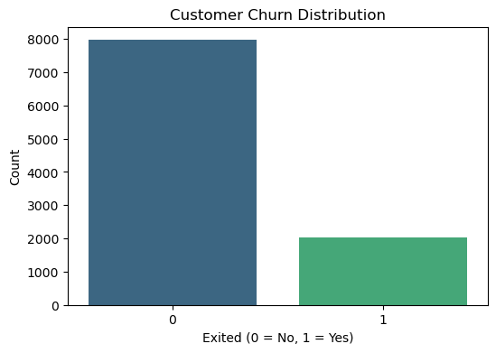
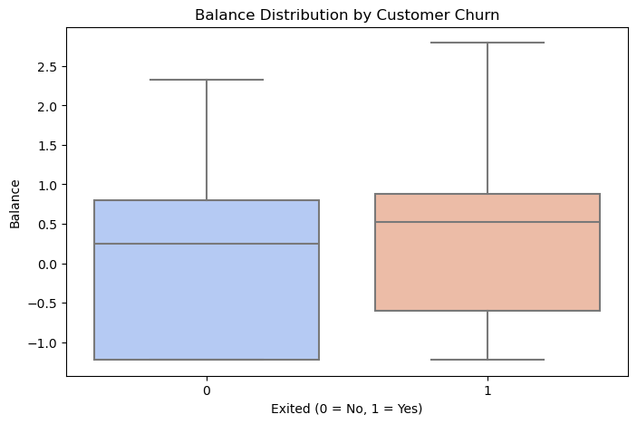
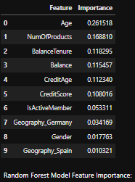
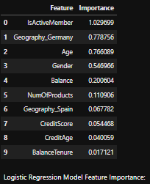
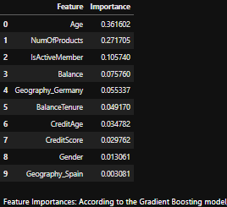
Using Machine Learning Techniques to Predict Customer Churn Rates
This project uses machine learning and data analytics techniques to predict bank customer churn. The developed model can be applied to increase bank customer loyalty and reduce churn risk.
1. Introdaction
Customer churn is a critical problem in the banking sector that affects profitability and customer loyalty. In this project, a model that can predict churn risk by analyzing customer data has been developed. This model can be used to develop targeted strategies by predicting customer churn.
2. Data Preprocessing
Dataset Introduction: This dataset contains demographic information, financial status and interaction data of a bank’s customers. The target variable is the Exited column, which indicates whether the customer has left the bank or not.
Data Preprocessing Steps:
Missing values ​​are filled with mean or mode.
Categorical variables such as Geography and Gender are made numerical.
Numerical variables such as CreditScore, Age, Balance and EstimatedSalary are standardized to improve the performance of the model.
3. Exploratory Data Analysis - EDA
Key Findings:
Age: In the age distribution analysis, it was seen that the risk of customer churn increases as age increases.
Customer Churn Rate: The rate of customers leaving the bank is 20%.
Credit Score: Customers with low credit scores have a higher churn rate.
Geography: The churn rate for customers in Germany is higher than in other countries.
4. Modeling and Performance Comparison
Applied Models:
Logistic Regression
Random Forest
Gradient Boosting
Performance Comparison:
Selection of the Best Model: Gradient Boosting model provided the highest accuracy and the best ROC-AUC score. This model was selected because it gave the most successful results in predicting customer churn.
Model | Accuracy | Precision | Recall | F1 Score | ROC-AUC
Logistic Regression | 0.808 | 0.556 | 0.208 | 0.303 | 0.763
Random Forest | 0.868 | 0.760 | 0.495 | 0.599 | 0.852
Gradient Boosting | 0.869 | 0.761 | 0.503 | 0.606 | 0.859
5. Feature Importance and Business Implications
Feature Importances:
Age: Age stands out as the most important feature in predicting customer churn. Older customers have a higher churn risk.
Num Of Products: The number of products a customer owns is an important factor affecting customer loyalty. Customers with more products have a lower churn risk.
Is Active Member: Inactive customers have a higher churn rate.
Balance: Customers with a higher balance have a higher churn risk.
Geography: Customers in Germany have a higher churn risk compared to other countries.
Business Implications:
Age-Specific Campaigns: Offer loyalty-boosting benefits to young customers.
Product Diversification: Increase product variety by offering new products to customers.
Interaction Programs for Inactive Customers: Increase loyalty by communicating more with low-interaction customers.
Geographically Focused Marketing: Develop special benefits and campaigns for customers in Germany.
6. Conclusion and Future Improvements
Conclusion: In this project, data analytics and machine learning techniques were used to predict customer churn in the banking sector. The Gradient Boosting model achieved the highest accuracy rate by providing the most successful results in predicting customer churn. Features such as age, number of products and active memberships stood out as determining factors in customer churn. These findings may contribute to the bank taking strategic measures to increase customer loyalty.
Recommendations for the Future:
Additional data sources (such as customer feedback) can be added to increase the accuracy of the model.
Time series analyses can be used to examine the change in customer churn over time.
More targeted predictions can be made by developing segment-based models.
Customer churn prevention strategies can be optimized with customer lifetime value (CLV) analyses.

